Slide 1

MACHINE LEARNING APPLIED: RATING PREDICTION BASED ON USER REVIEWS.
Anshul Shrivastava

Slide 2


Agenda
Introduction
Data Collection
Pre- Processing data with NLP
Model/s Development and Evaluation
Conclusion

Slide 3
Introduction
With brands vying to win customers over with aggressive marketing, online reviews have become an important consideration for consumers. Over 88% of Ecommerce shoppers buy only after reading reviews of products. Product ratings and reviews secure the customer journey by giving them the confidence to complete the checkout process. User-generated content provides valuable consumer insights. It helps Ecommerce retailers understand the needs of consumers. Brands can use this information to ideate, improve and innovate products or services, foster customer loyalty, and improve their business.

Slide 4

Data Collection
Web Scraping with Beautiful Soup and Selenium

Slide 5
Data Sources and their formats.
We have a client who has a website where people write different reviews for technical products. Now they are adding a new feature to their website i.e. The reviewer will have to add stars(rating) as well with the review. The rating is out 5 stars and it only has 5 options available 1 star, 2 stars, 3 stars, 4 stars, 5 stars. Now they want to predict ratings for the reviews which were written in the past and they don’t have a rating.
So, we have to build an application which can predict the rating by seeing the review. On seeing the above problem definition, I have tried in building a successful machine learning model that will predict the rating based on the reviews given by the customer. But to train the model we require some data to play around. So, I have scraped some data from multiple ecommerce websites along with the ratting for the reviews. Web scraping or data collection is done with the help of Beautiful Soup and Selenium, and I have collected more than 50000 records with ratings and reviews and have stored in CSV format

Slide 6
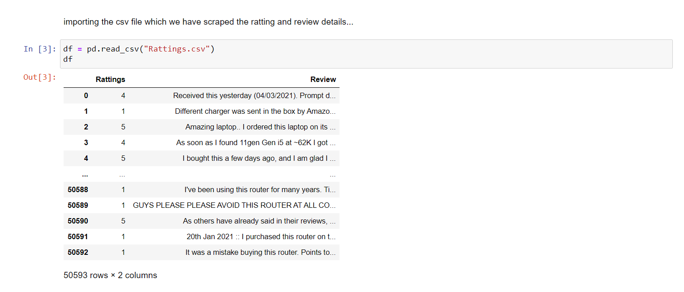
Collected Data

Slide 7
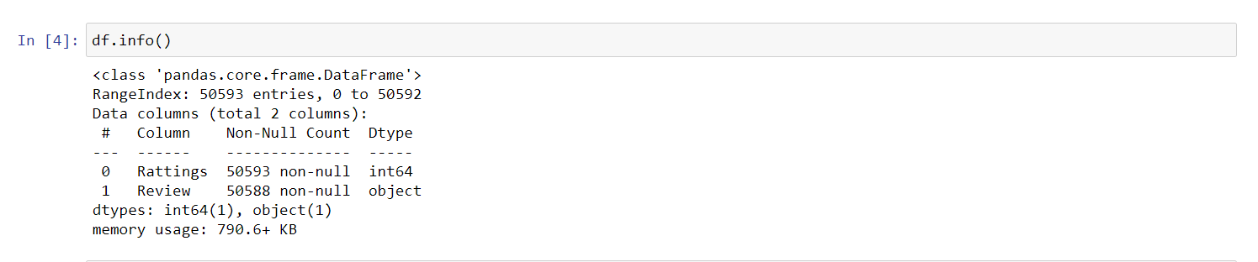
Collected Data

Slide 8
Pre- Processing data with NLP
EDA with NLP

Slide 9

Exploratory data analysis.
In statistics, exploratory data analysis is an approach of analyzing data sets to summarize their main characteristics, often using statistical graphics and other data visualization methods.

Slide 10
Exploratory data analysis
Step1
Converting all the strings into lower case
Step2
Converting all the email address present in the reviews as “email address”.
Step3
Converting all the currency present in the reviews as “dollars”.
Step4
Converting all phone numbers present in the reviews as “phonenumber”.
Step5
Removed all punctuations and stop words and lemawords from the reviews.
Have converted all the number present in the reviews as “number”.

Slide 11
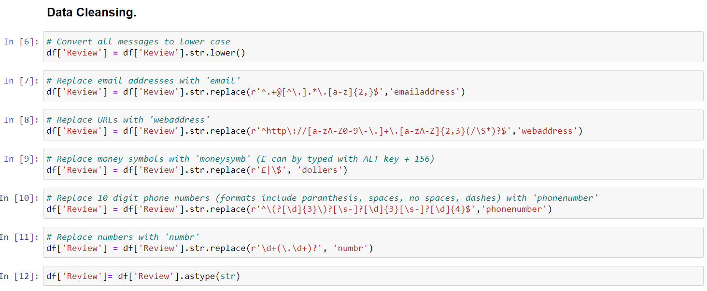
Exploratory data analysis

Slide 12
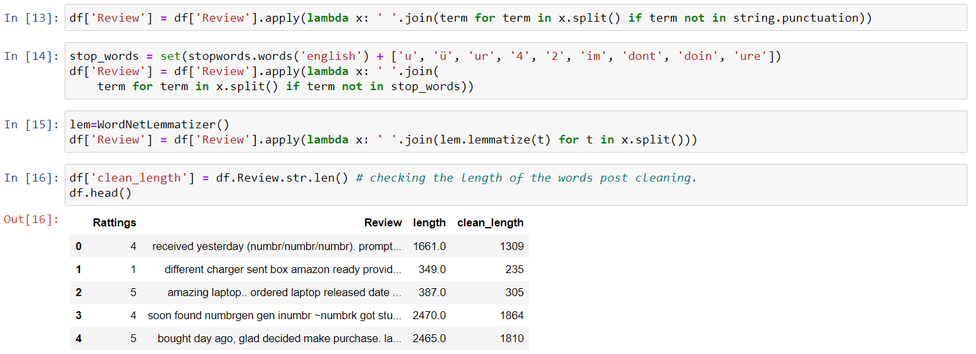
Exploratory data analysis

Slide 13
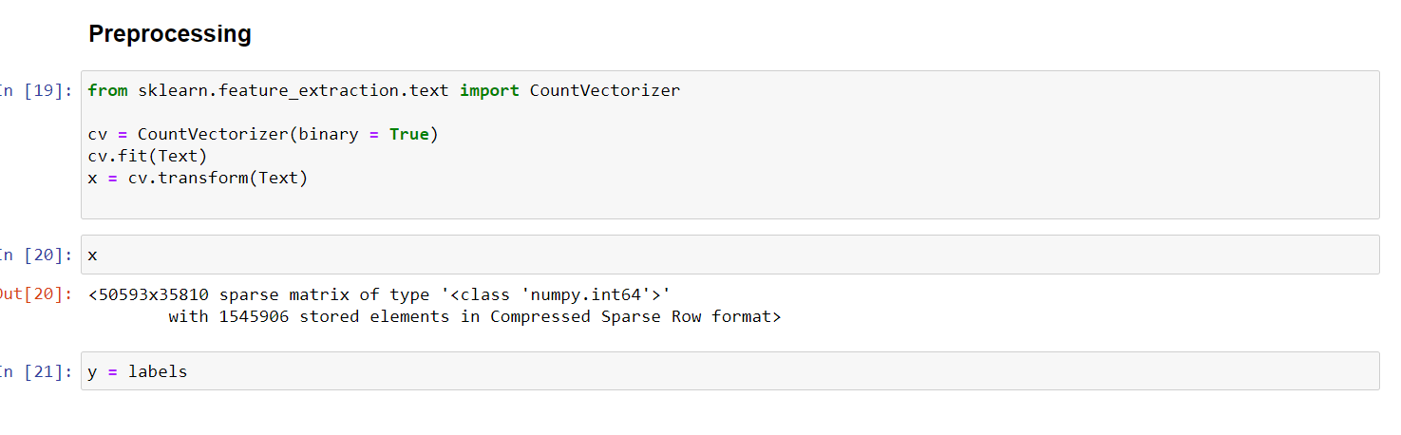
Count vectorizer for Preprocessing.

Slide 14
Model/s Development and Evaluation
“Logistic Regression", "Naive Bayes Gaussian", "Random Forest", "Decision Tree", "Extra Tree", "Ada Boost", "Gradient Boosting", "XGBoost”.

Slide 15
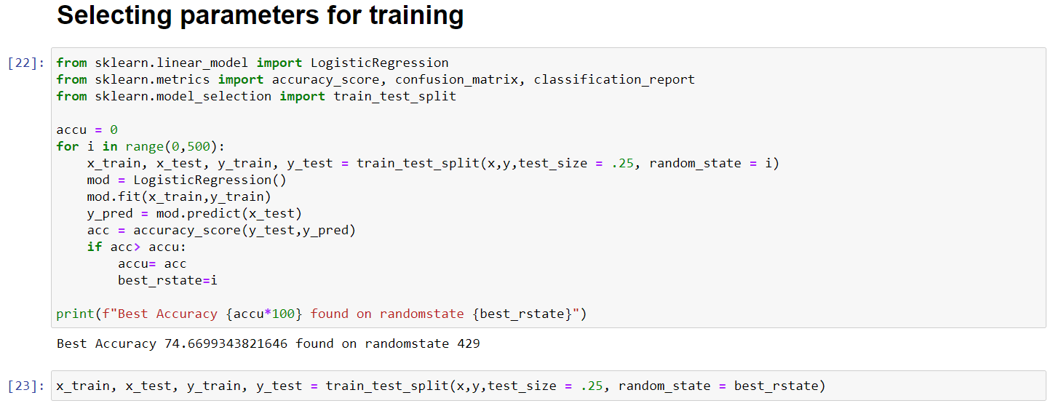
Selecting best random state parameters for training.
With logistic regression I have created a loop between 0-500 to sort the best random state parameters with highest accuracy.

Slide 16
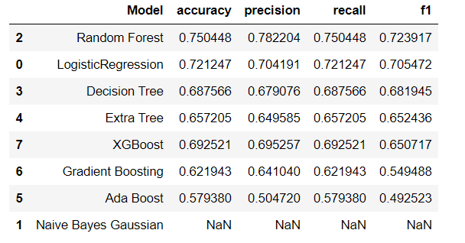
Testing of Identified Approaches (Algorithms).
I have used eight different algorithms and tried in sorting the top performed algorithm they are “Logistic Regression", "Naive Bayes Gaussian", "Random Forest", "Decision Tree", "Extra Tree", "Ada Boost", "Gradient Boosting", "XGBoost”.

Slide 17
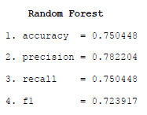
Testing of Identified Approaches (Algorithms).
From above table its evident that Random Forest Algorithm tops the chart which is further tuned and saved.

Slide 18
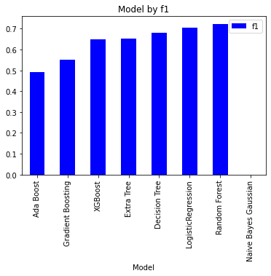
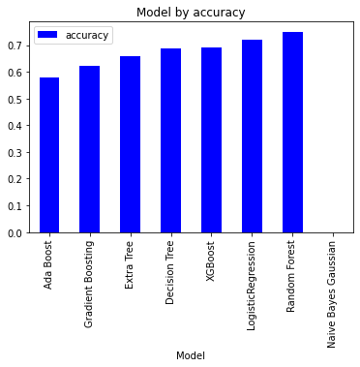
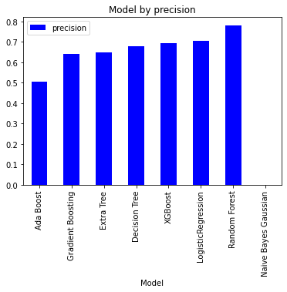

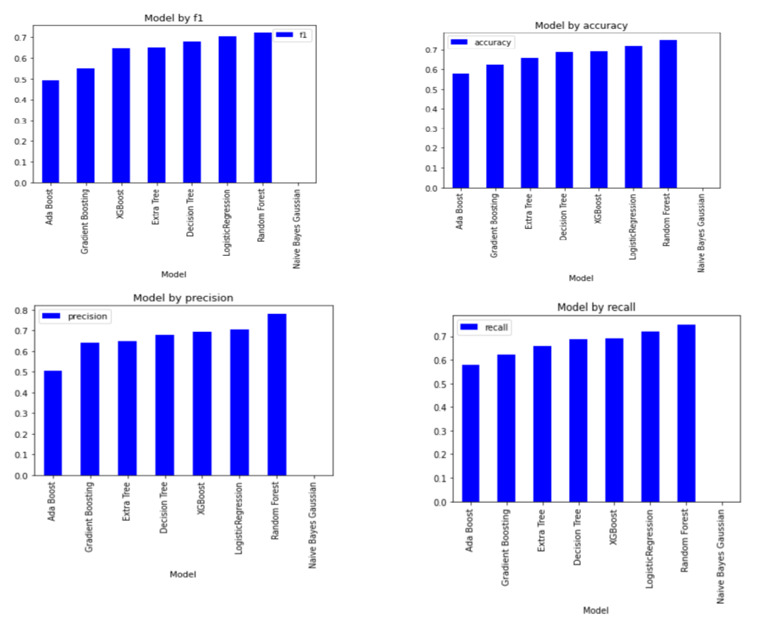
Visualizations.
As like said earlier I have trained using eight different models and finalized Random Forest as top performed model we are visualizing the metrics of these models.
Seeing the performance, I have finalized Random Forest model and hyper parameter tuned and saved the same.

Slide 19

Conclusion
Online reviews are an effective word of mouth marketing strategy in the digital age, providing outside perspectives on products and services. While positive reviews can drive revenue and build a trustworthy reputation, negative reviews or the absence of reviews can do the opposite. Understanding the importance of reviews as well as how to leverage them to boost your business can be a critical way to get ahead in the competitive ecommerce marketplace, positioning yourself miles ahead of the competition.

Slide 20



THANK YOU
Anshul Shrivastava

